Slide 1
Recurrent Neural Networks (RNNs)
Deep Learning Applications
Notes:
Introduce RNNs as a crucial component of deep learning, highlighting their ability to handle sequential data and temporal relationships. Explain how RNNs are inspired by the human brain and have numerous applications. Ask students to consider how RNNs can be used in real-world scenarios.

Slide 2
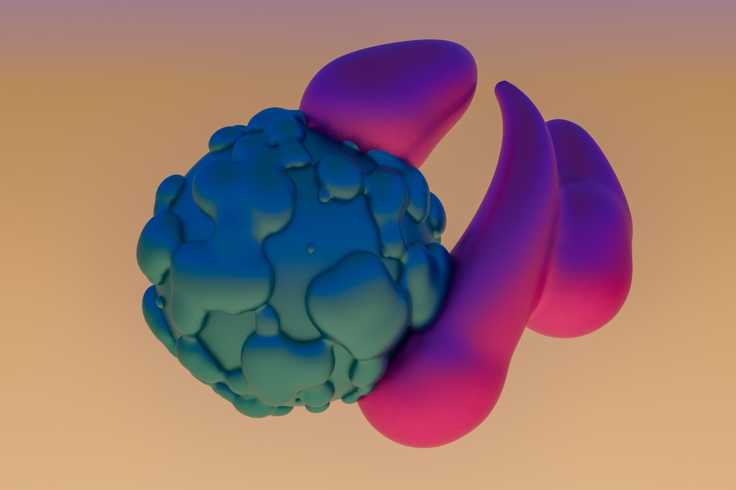
RNN Architecture
Feedback connections allow loops
Hidden state captures history
Input, output, and hidden layers
Simple, yet powerful structure
Image_query: RNN architecture diagram
Feedforward, feedback, and output
Recurrent connections enable memory
Activation functions introduce non-linearity
Backpropagation used for training
Notes:
Describe the basic RNN architecture, emphasizing the role of feedback connections and the hidden state. Show an image of the RNN architecture diagram and explain each component. Discuss how the simple structure of RNNs allows for complex pattern recognition and prediction.

Slide 3
RNN Cell Dynamics
h(t) = f(h(t-1), x(t))
Cell state updated at each step
Hidden state captures temporal info
Activation functions control output
Non-linearity introduced by sigmoid
Tanh function used for hidden state
Cell dynamics enable pattern learning
Internal state updated recursively
Enabling RNNs to learn sequences
Notes:
Explain the dynamics of an RNN cell, using the equation h(t) = f(h(t-1), x(t)) to illustrate how the hidden state is updated. Discuss the role of activation functions and the introduction of non-linearity. Emphasize how the cell dynamics allow RNNs to learn complex patterns in sequential data.

Slide 4
Training RNNs
Backpropagation through time (BPTT)
Truncated BPTT for efficiency
Stochastic gradient descent (SGD)
Mini-batch training for stability
Regularization techniques used
Dropout prevents overfitting
Early stopping avoids overtraining
Learning rate scheduling improves convergence
Gradient clipping stabilizes training
Notes:
Discuss the challenges of training RNNs and introduce backpropagation through time (BPTT) as a solution. Explain the importance of truncated BPTT, SGD, and mini-batch training. Emphasize the need for regularization techniques, such as dropout and early stopping, to prevent overfitting and improve training stability.

Slide 5
RNN Applications
Speech recognition and synthesis
Natural language processing (NLP)
Time series forecasting and analysis
Image and video processing
Chatbots and dialogue systems
Sentiment analysis and opinion mining
Machine translation and localization
Recommendation systems and advertising
Financial prediction and portfolio management
Notes:
Highlight the diverse range of RNN applications, from speech and language processing to image and video analysis. Emphasize the importance of RNNs in real-world applications, such as chatbots, sentiment analysis, and financial prediction. Ask students to consider how RNNs can be used to improve existing products and services.

Slide 6
Vanishing/Exploding Gradients
Gradients vanish or explode
Causing training instability
Sigmoid and tanh functions contribute
Gradient clipping and normalization
Weight initialization techniques
Batch normalization and layer normalization
Residual connections and skip links
Gated recurrent units (GRUs) and LSTMs
Help mitigate vanishing/exploding gradients
Notes:
Explain the problem of vanishing and exploding gradients in RNNs, highlighting the role of sigmoid and tanh functions. Discuss various techniques to mitigate this issue, such as gradient clipping, weight initialization, and batch normalization. Introduce GRUs and LSTMs as alternative RNN architectures that can help alleviate this problem.

Slide 7
Long Short-Term Memory (LSTM) Networks
LSTMs introduce memory cells
Gates control information flow
Input, output, and forget gates
Cell state updated through gates
LSTMs mitigate vanishing gradients
Enable learning long-term dependencies
Used in speech, language, and music
LSTM variants: peephole, coupled
Bidirectional LSTMs for sequence tagging
Notes:
Introduce LSTMs as a variant of RNNs that can learn long-term dependencies. Explain the role of memory cells and gates in controlling information flow. Discuss the advantages of LSTMs, including their ability to mitigate vanishing gradients and learn complex patterns. Highlight various applications of LSTMs, including speech, language, and music processing.

Slide 8
Conclusion
RNNs process sequential data
Capture temporal relationships
Enable dynamic input/output
LSTMs and GRUs improve performance
RNNs have numerous applications
From speech to image processing
Real-world applications abound
RNNs are a fundamental deep learning
Continued research and development
Notes:
Summarize the key takeaways from the presentation, emphasizing the importance of RNNs in deep learning. Highlight the advantages of LSTMs and GRUs, and discuss the diverse range of RNN applications. Encourage students to continue exploring RNNs and their applications, and emphasize the need for ongoing research and development in this field.

